Slide 1


Maintaining Viability with Multiple Needs
Connor McShaffrey &
Randall Beer

Slide 2
Overview
Central Question
Will an organism survive or perish in an environment without conditions that meet its various needs?
Intended Takeaways
A parametric scan of survivability in fixed environmental conditions is not the viability region of a behaving organism.
That same parametric scan of environmental conditions is not representative of the types of environments the organism can adapt to.

Slide 3
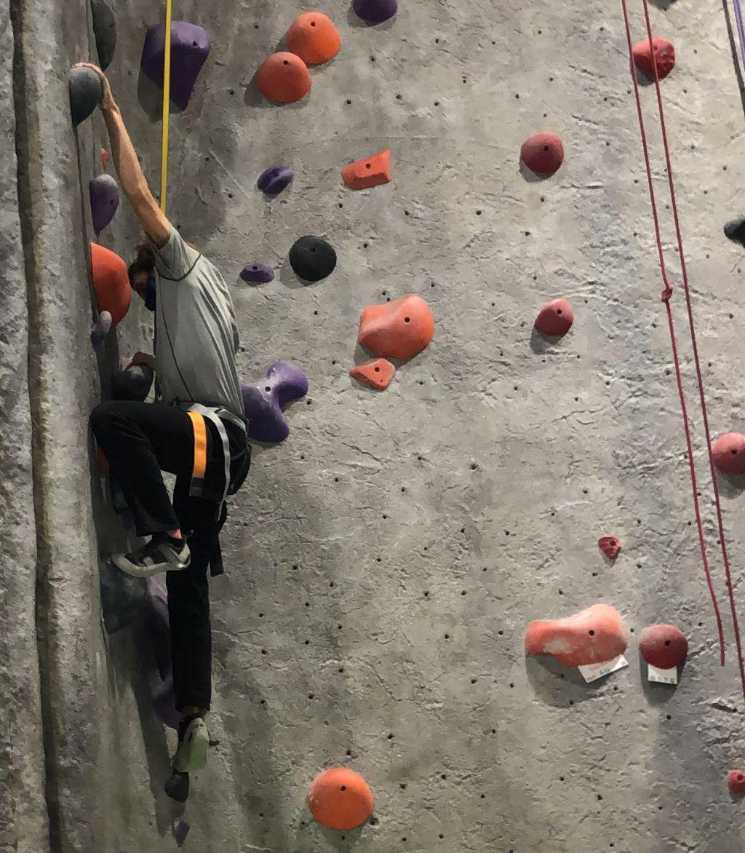
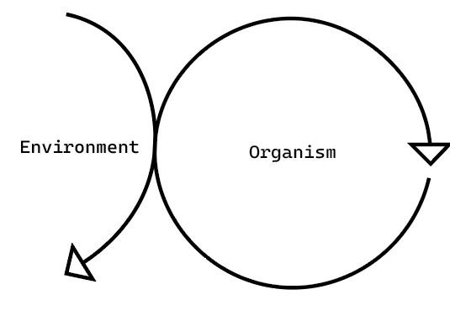
Adaptive Behavior & Viability (Maturana & Varela, 1980; Beer, 1995)
Embodied Behavior
Physical Constitution / Autopoiesis

Slide 4
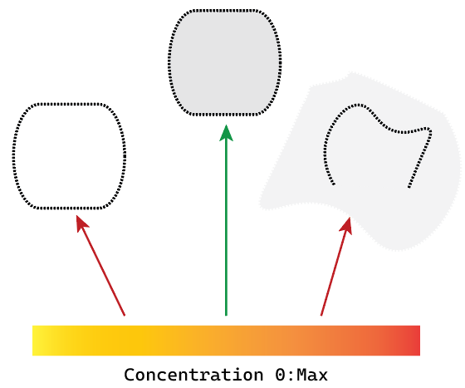
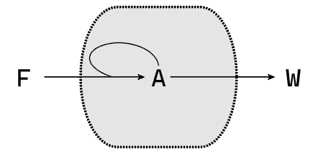
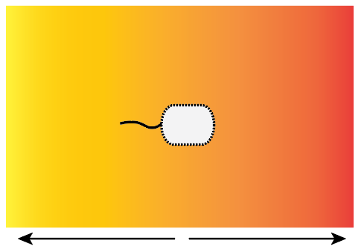
Using Protocells to Develop Viability Theory (Egbert et al. 2013, 2014, 2016)
1) 2)
3)

Slide 5
Step 1:
Defining the Protocell and Viability Region

Slide 6
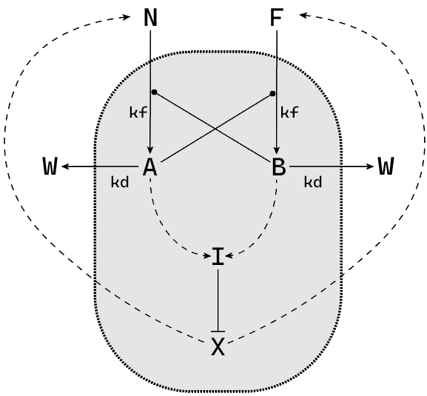
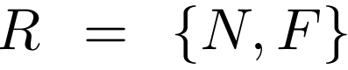
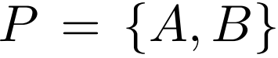
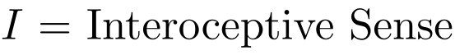
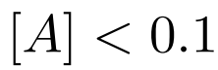
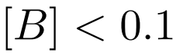

Step 1: A Novel Protocell with Multiple Needs
Central Metabolism
Regulatory System
Viability Limits

Slide 7
Step 2:
Finding Survivable Conditions (No Behavior)

Slide 8
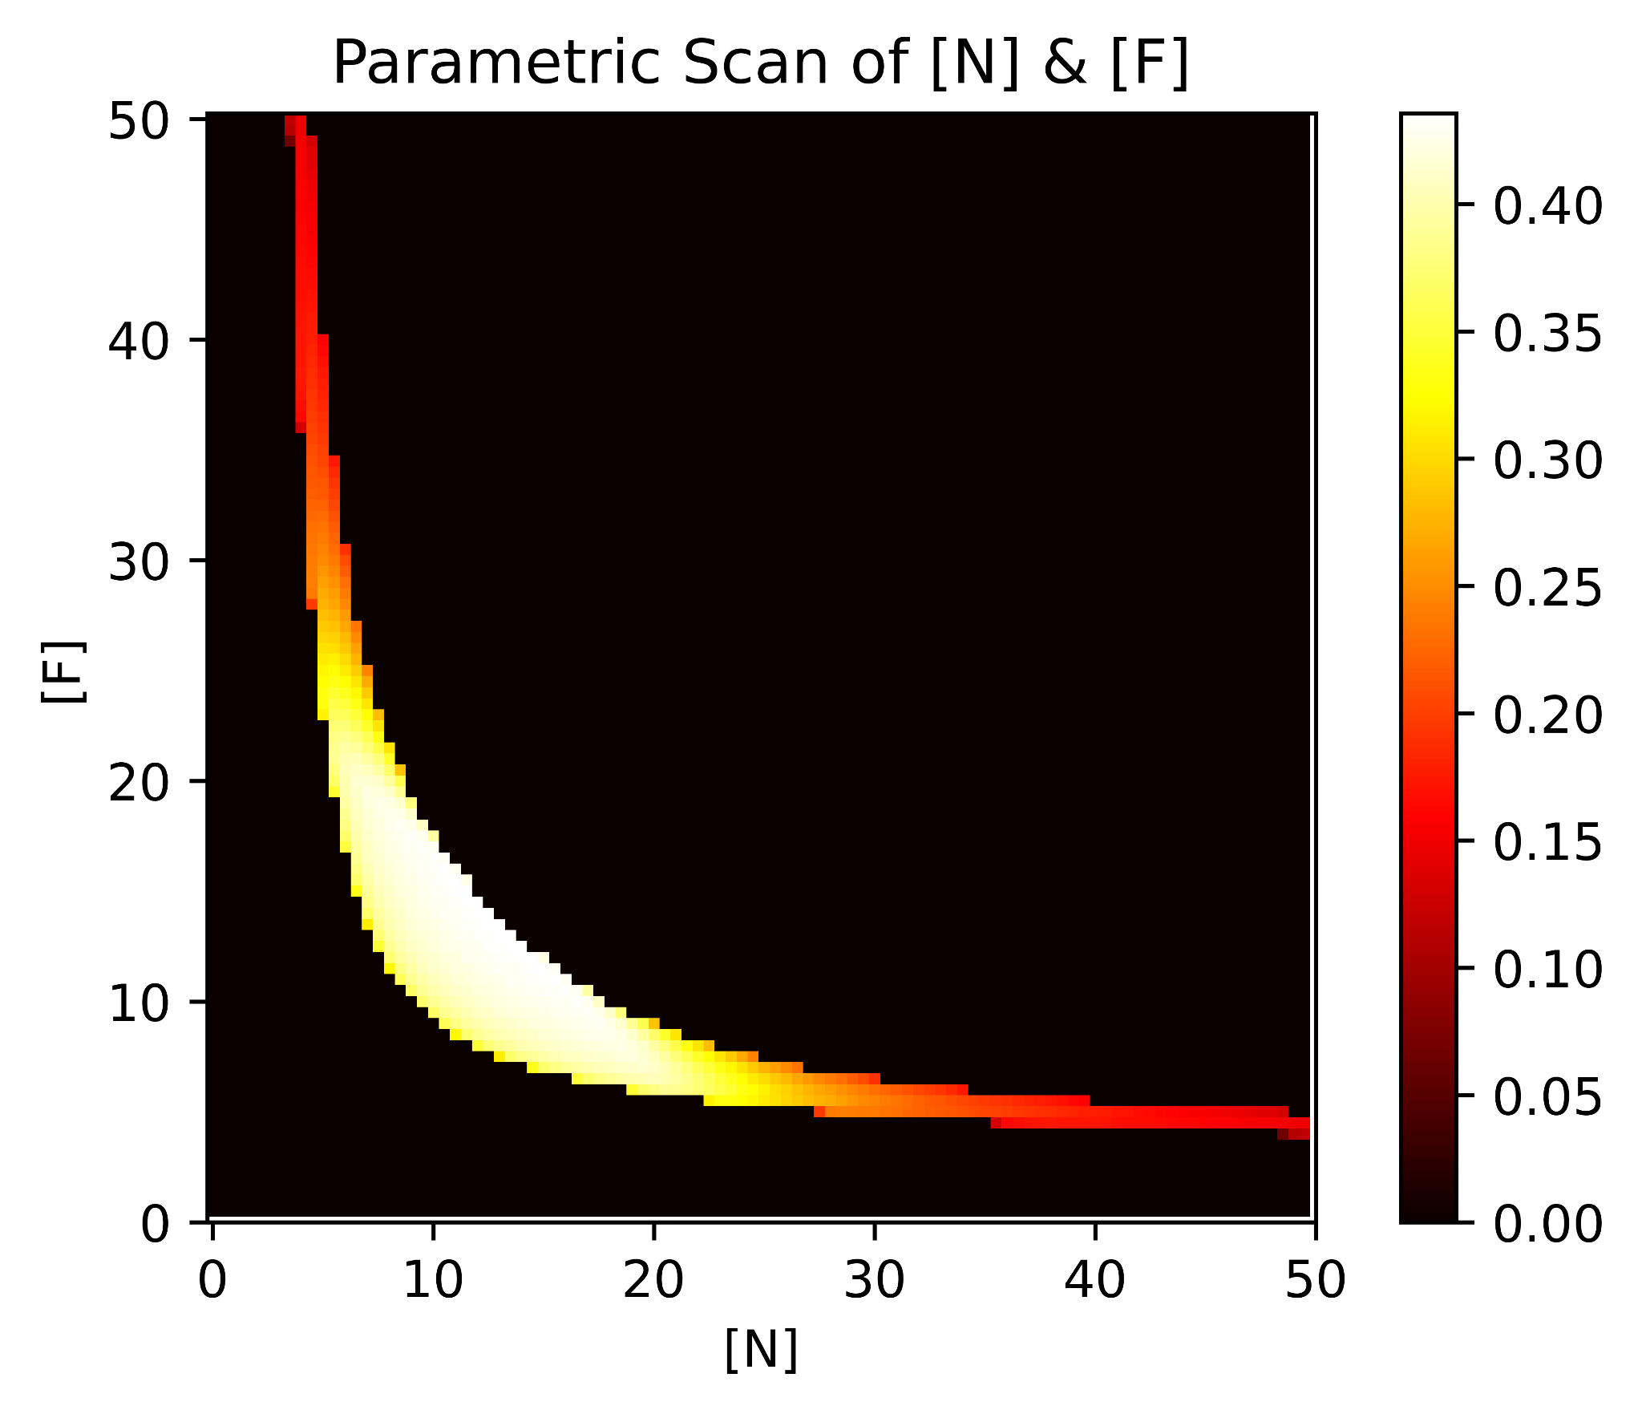
Step 2: Analyzing Viability in Fixed Conditions
10,000 combinations of reactant concentrations (0:50) are assessed for 800 Arbitrary Time Units for 2,500 different initial conditions of the central metabolism (0:20).
Heat is the proportion of tested initial conditions that remain alive for 800 ATU.

Slide 9
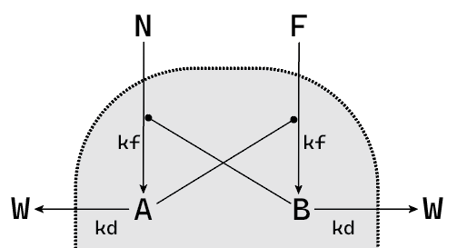
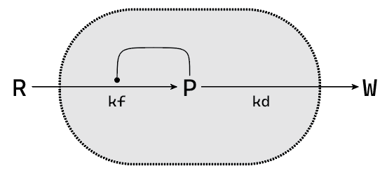
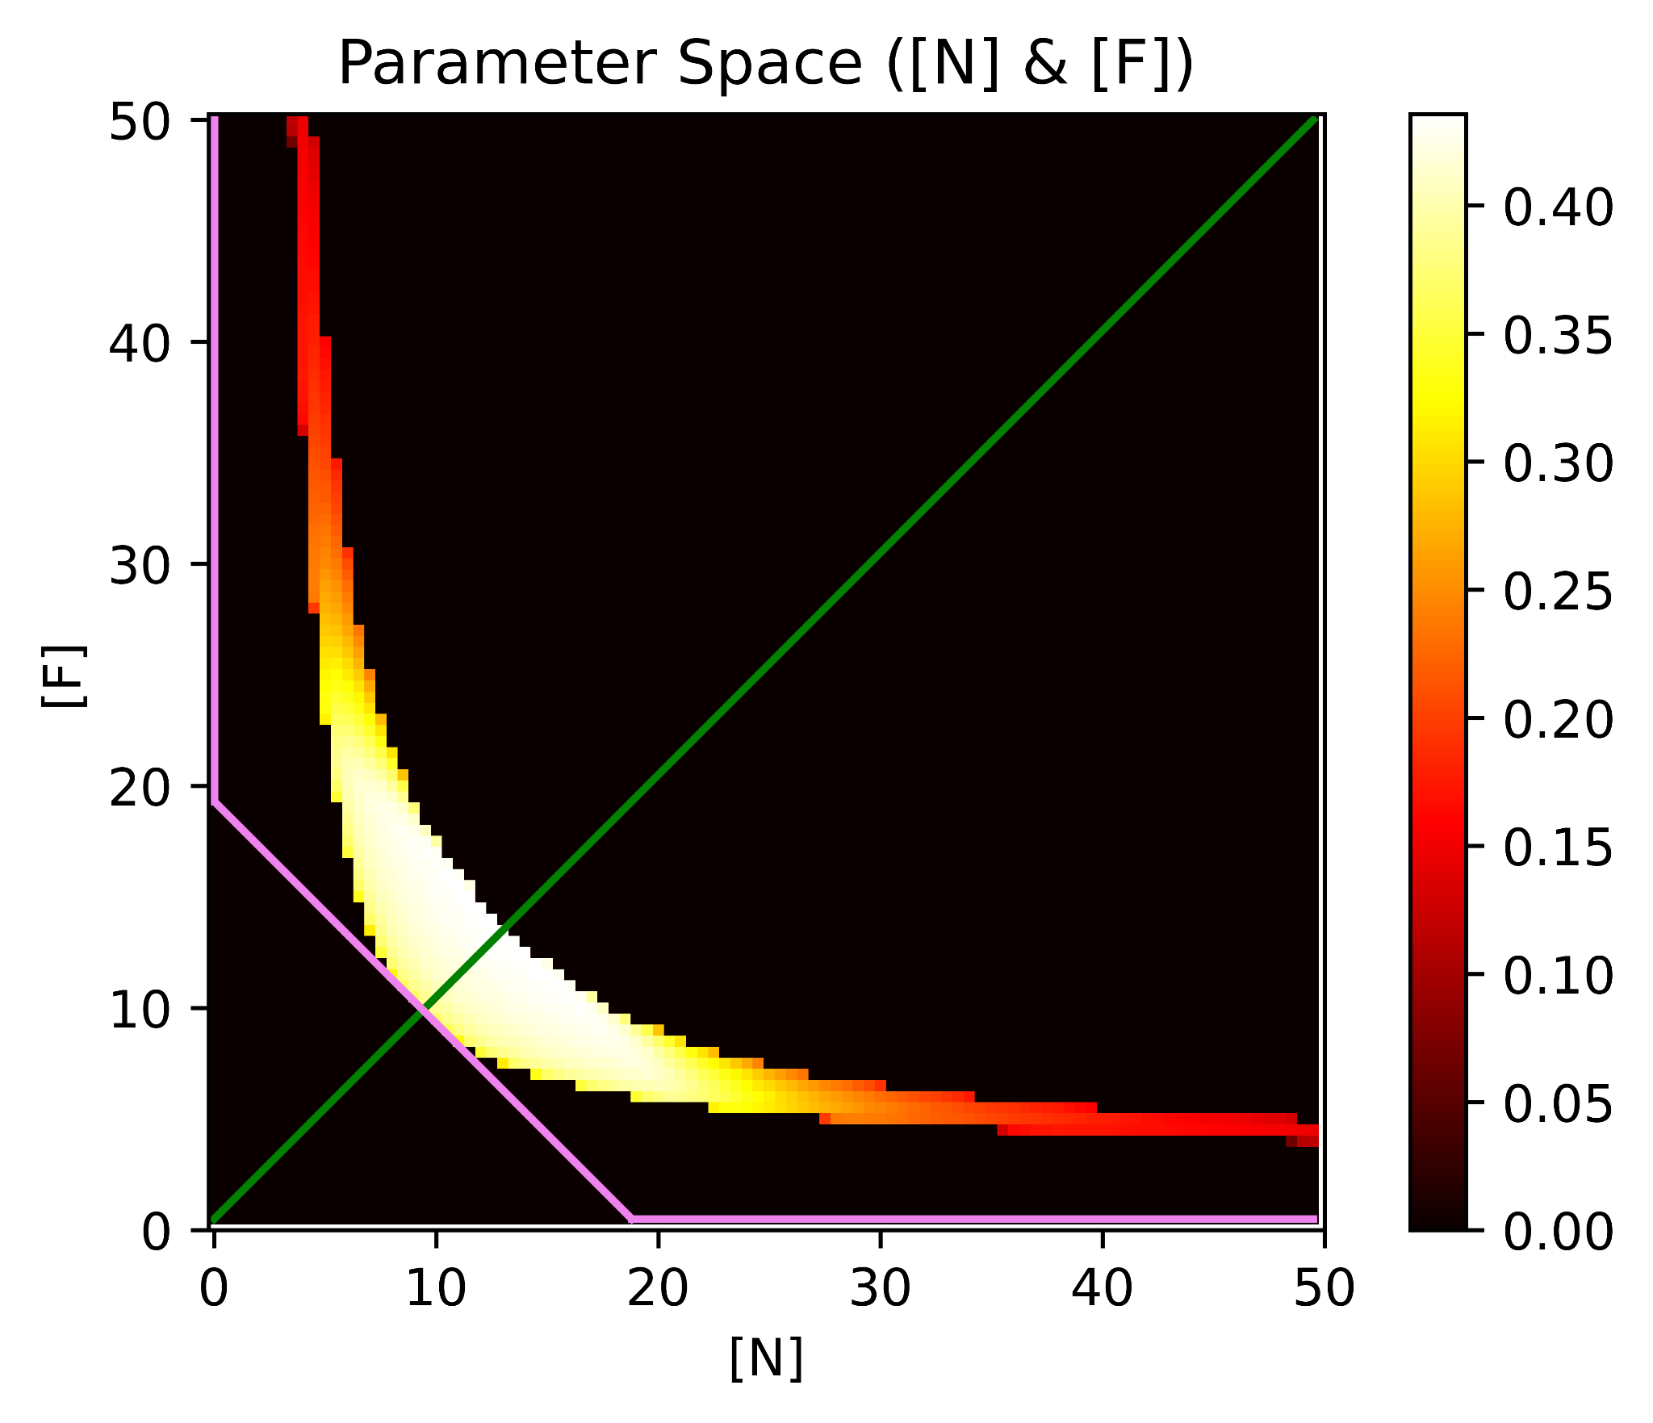
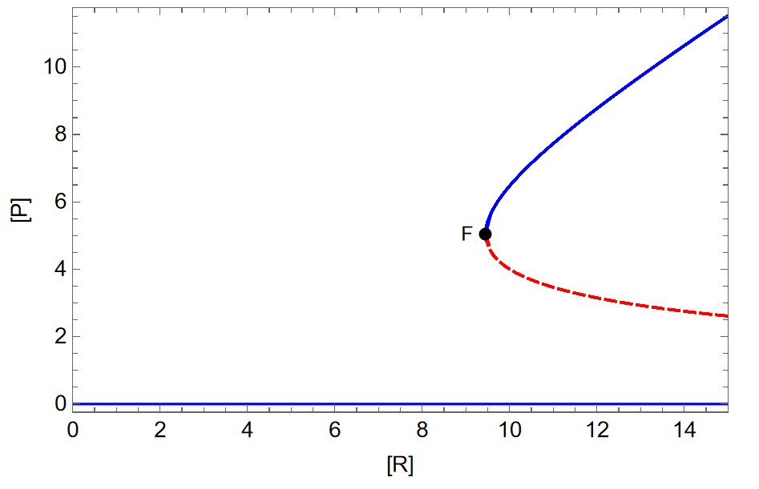
Why Does Viability Emerge?

Slide 10
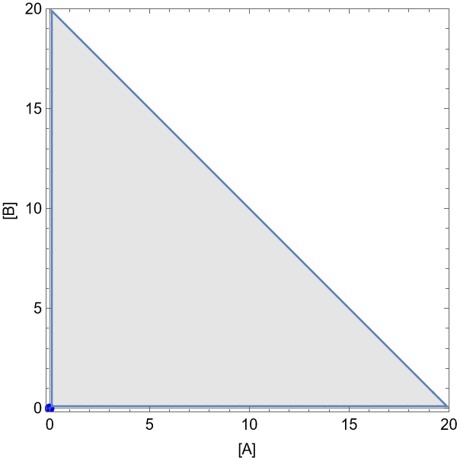
Phase & Viability Space as [R]’s Increase

Slide 11
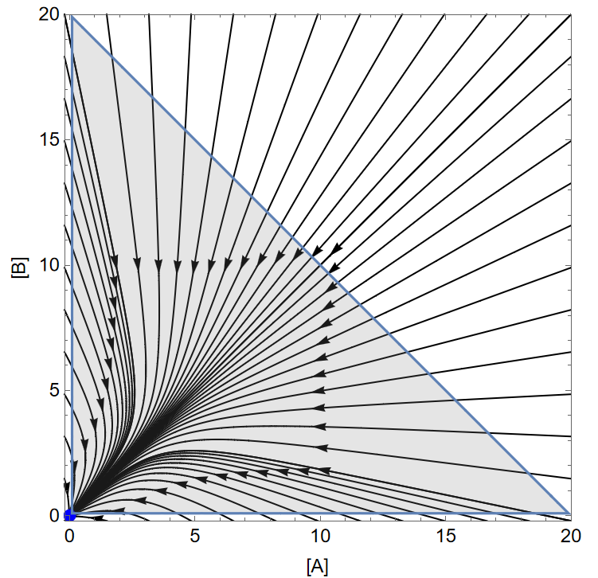
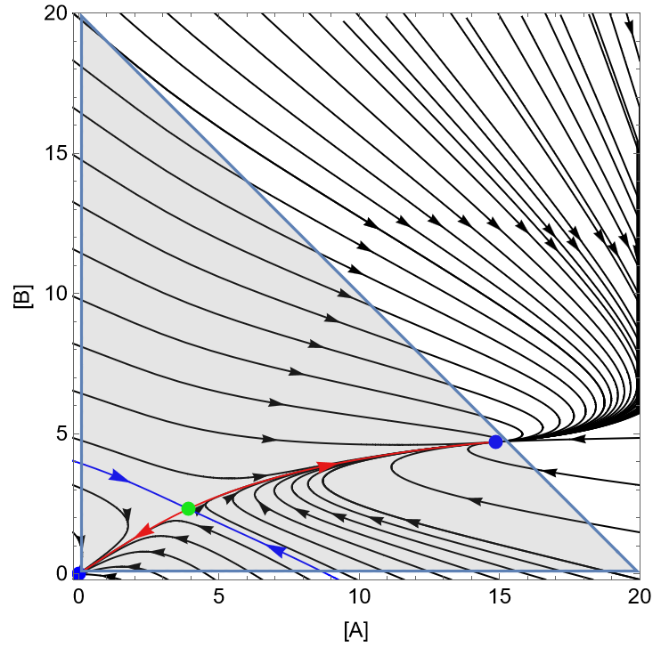
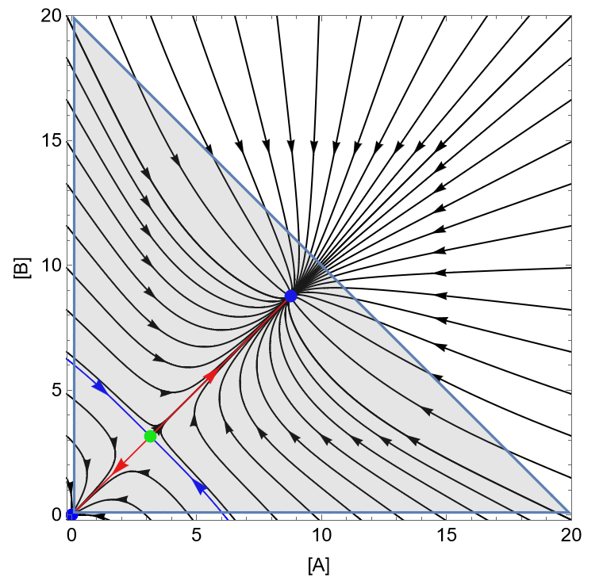
Why Does Survival Become Less Likely?

Slide 12
Step 3:
Behavior in an Environment

Slide 13
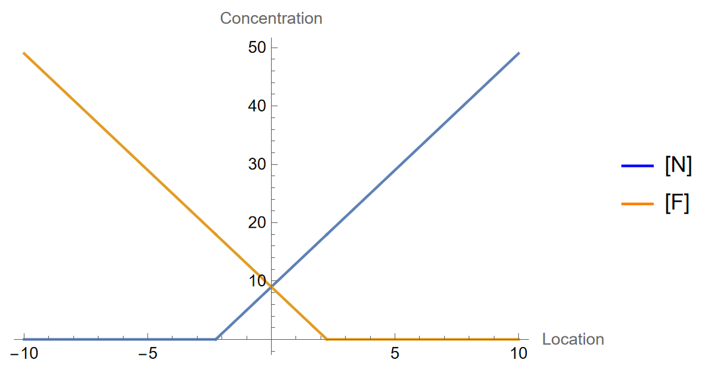
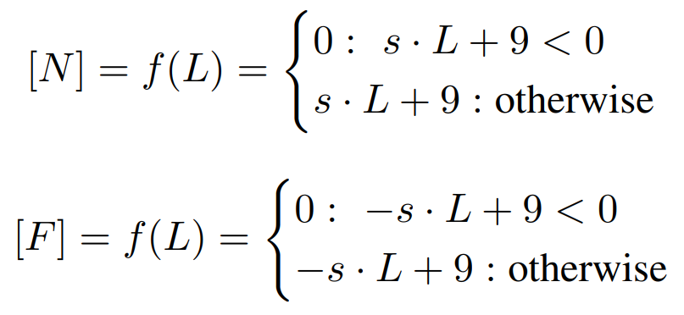
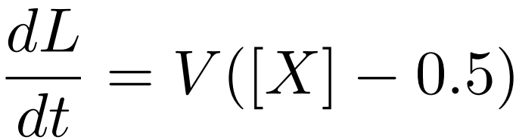
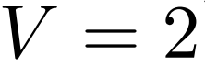
Step 3.1: Environments Outside of Viable Conditions

Slide 14
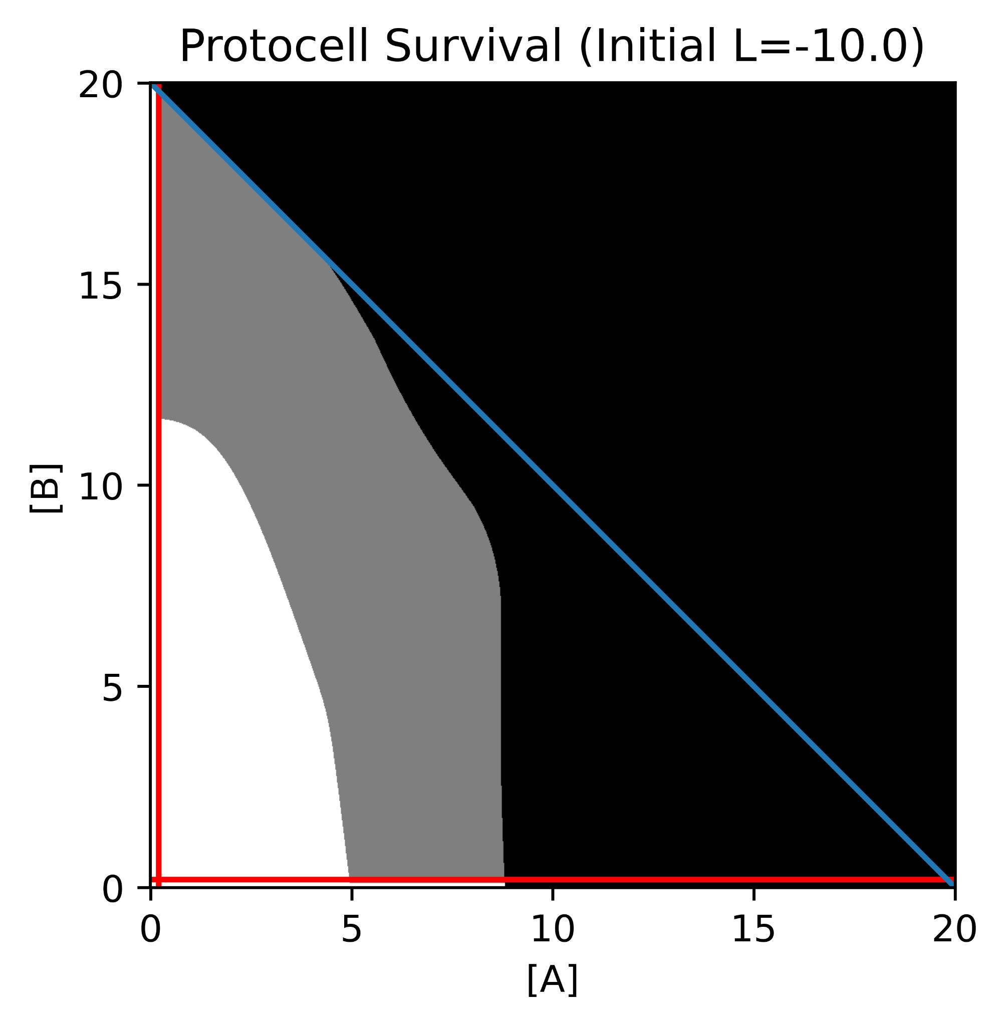
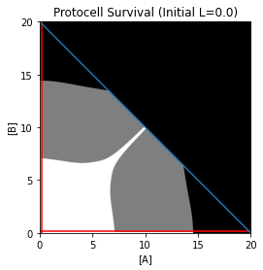
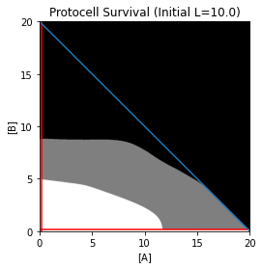
Step 3.2: Viability & Agent-Environment Interaction
= Remains Viable
= Decays
= Bursts

Slide 15
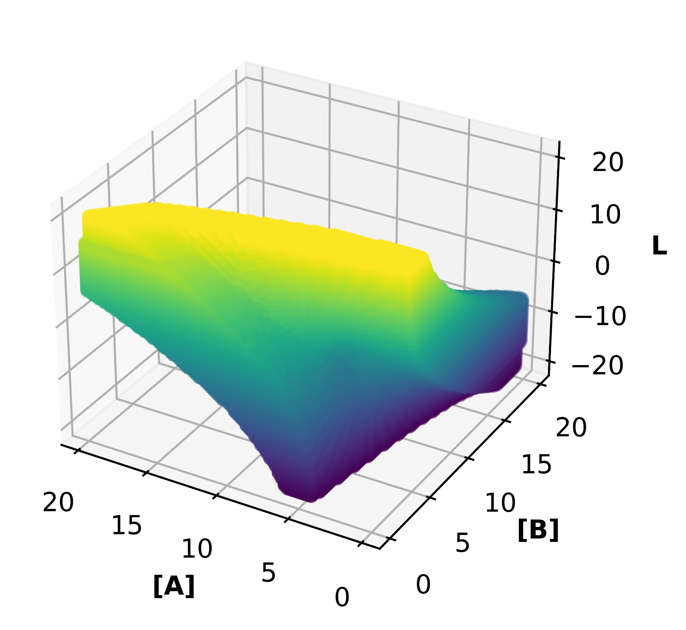
Step 3.2: Viability & Agent-Environment Interaction

Slide 16
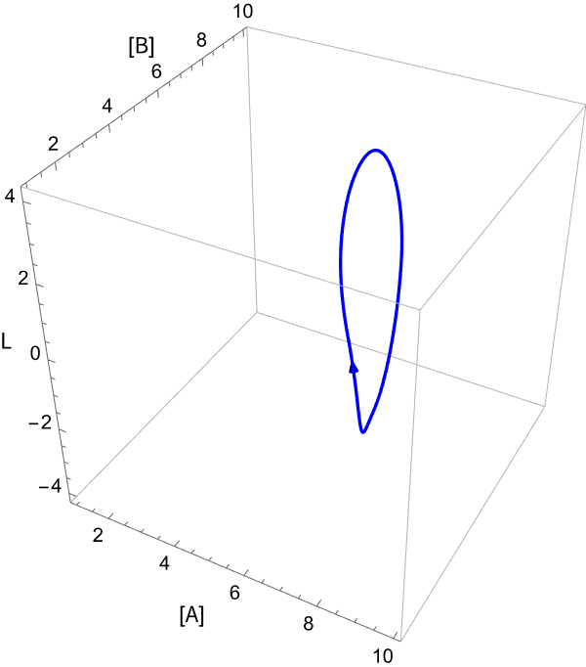
Survival in Unexpected Conditions

Slide 17
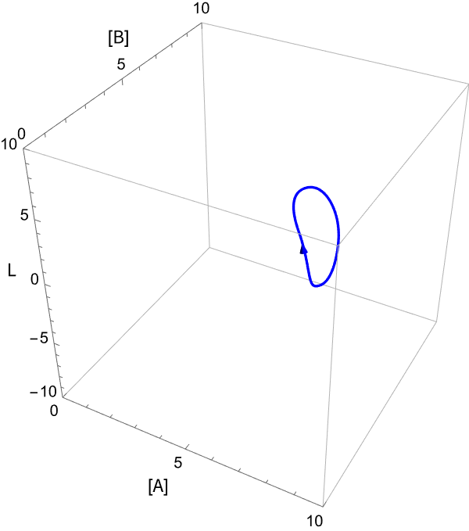
Decay & Delaying the Inevitable

Slide 18
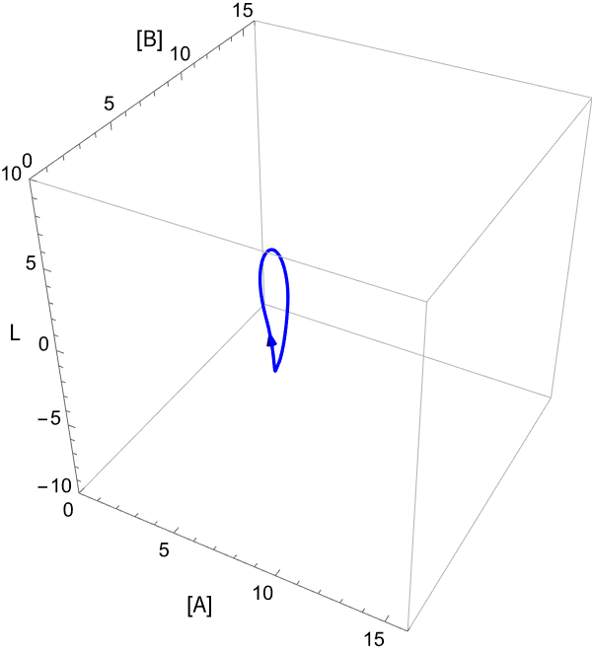
Bursting & Death in the Transient

Slide 19
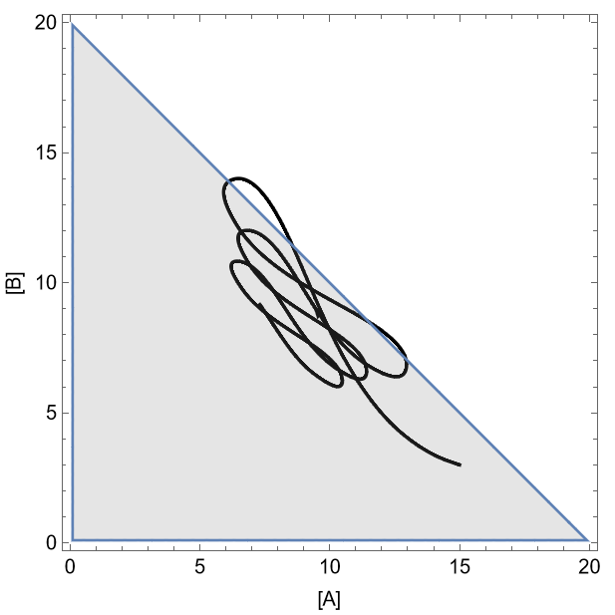
Bursting & Death in the Transient

Slide 20
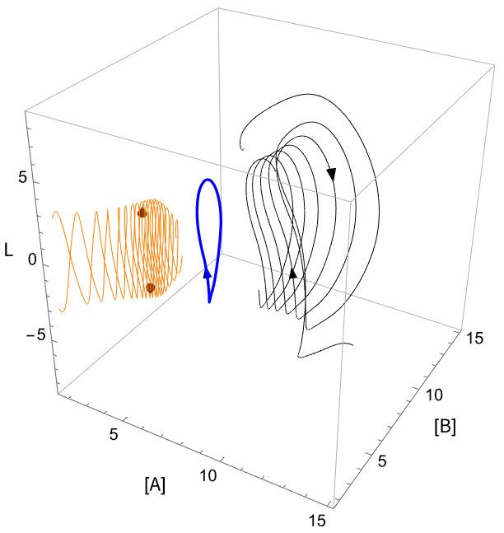
The Irreducibility of Agent-Environment Dynamics

Slide 21
Conclusions
What makes a range of conditions survivable is not inherent. It depends on how they stand relative to one another, and how an organism moves between adjacent possibilities.
The interaction between behavioral and metabolic dynamics creates a nonlinear dynamical system that cannot be anticipated in a parametric scan of a lower dimensional subset.
As dissipative systems with multiple needs, in many cases a given local environment will not sustain an organism.

Slide 22
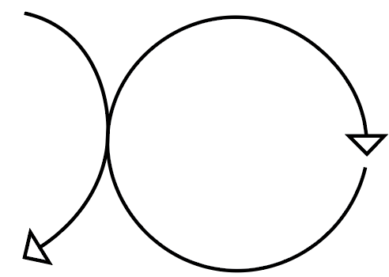

Thank You!
cmcshaff@iu.edu

Slide 23
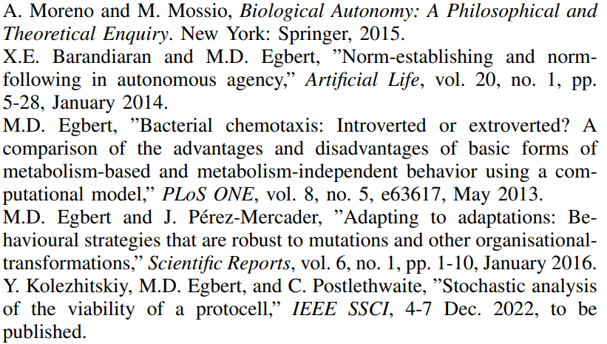
References:

Slide 24
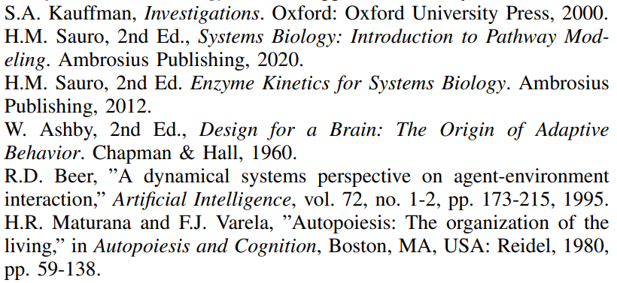
References:

Slide 25
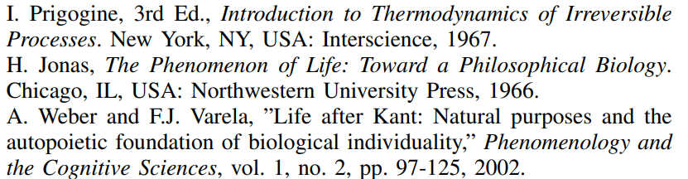
References:

Slide 26
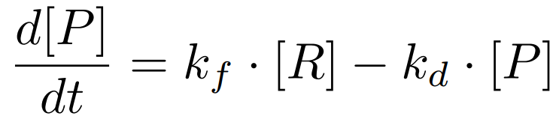
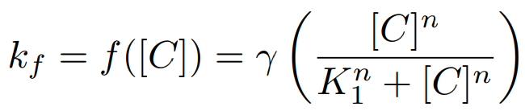
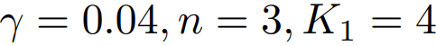
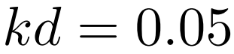
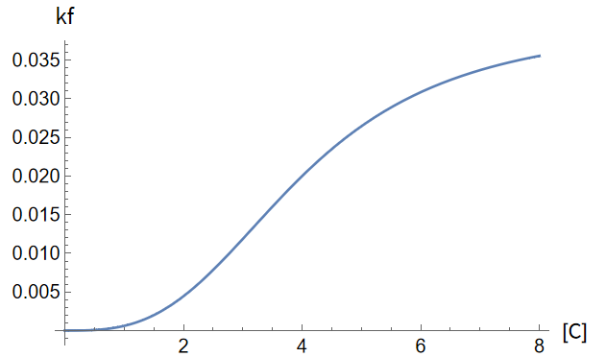
Step 1.1: Autocatalysis & the Central Metabolism

Slide 27
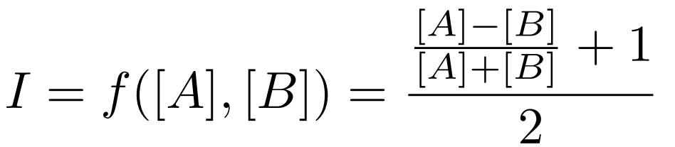
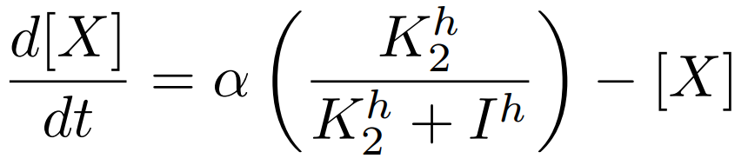
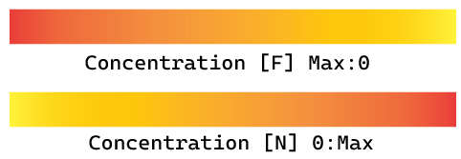
Step 1.2: Behavioral Subsystem

